Slide 1



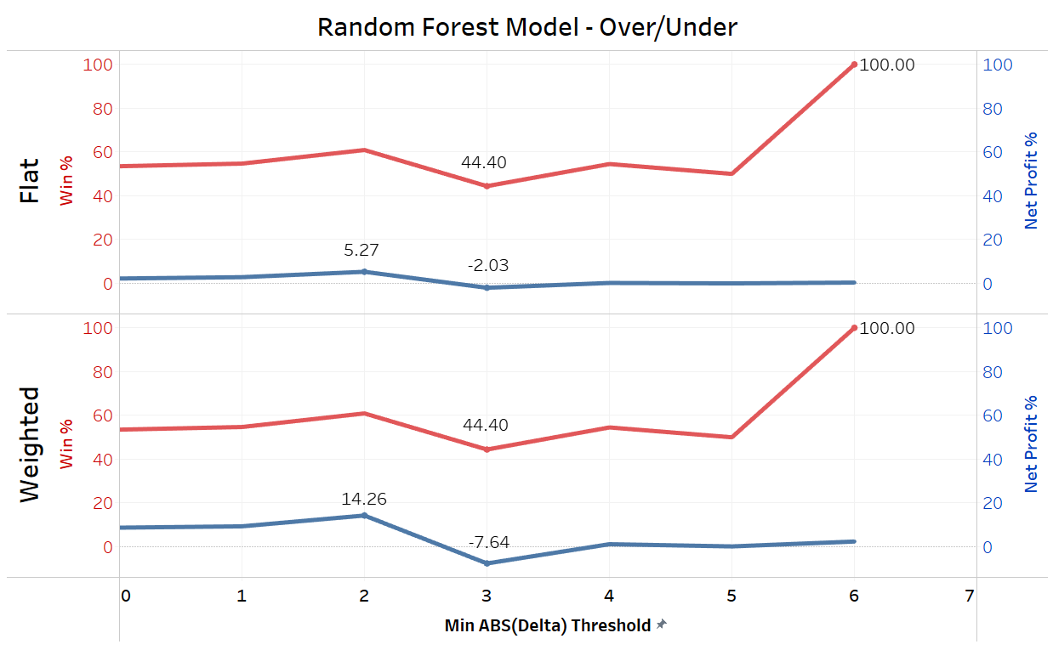
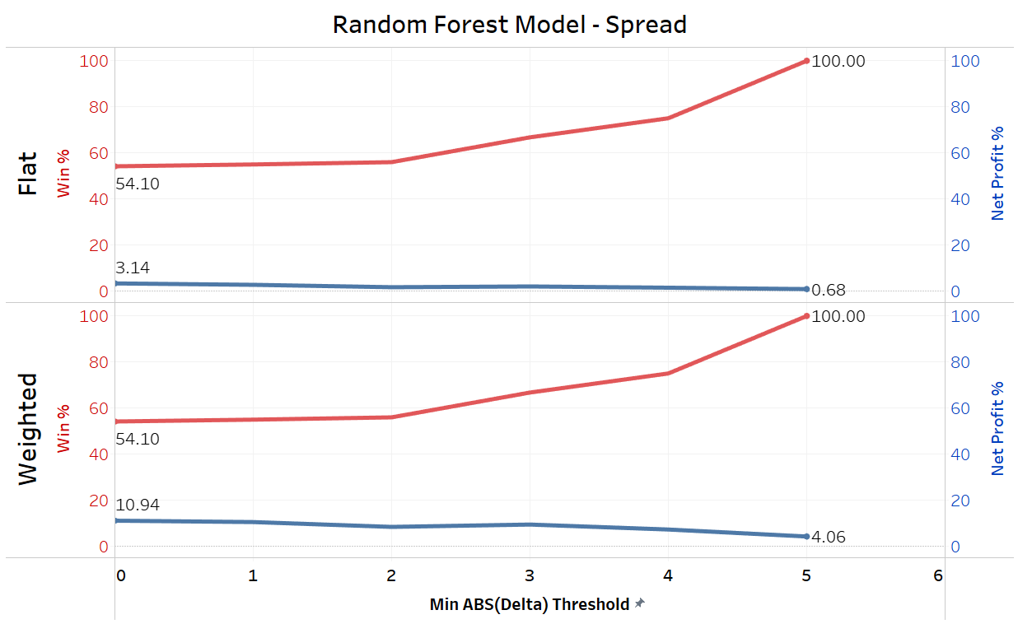
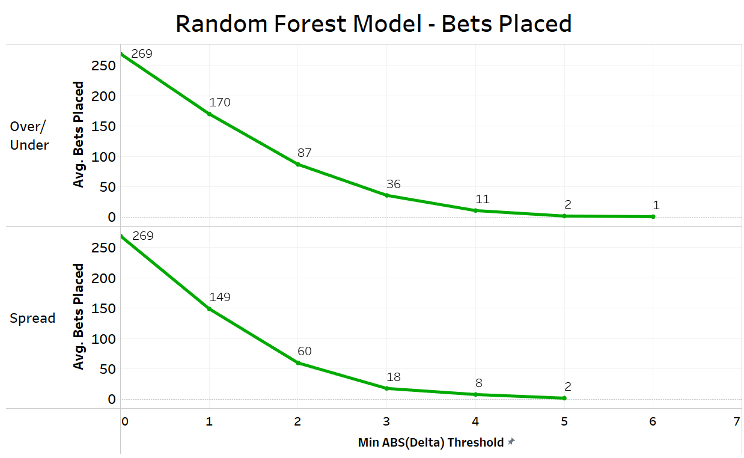
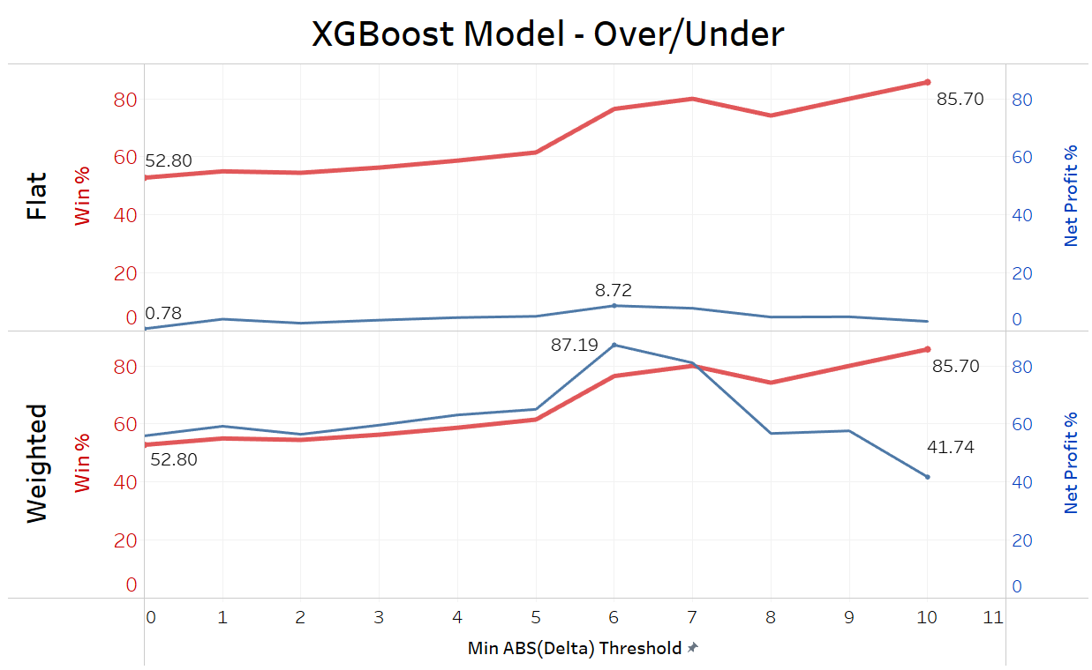
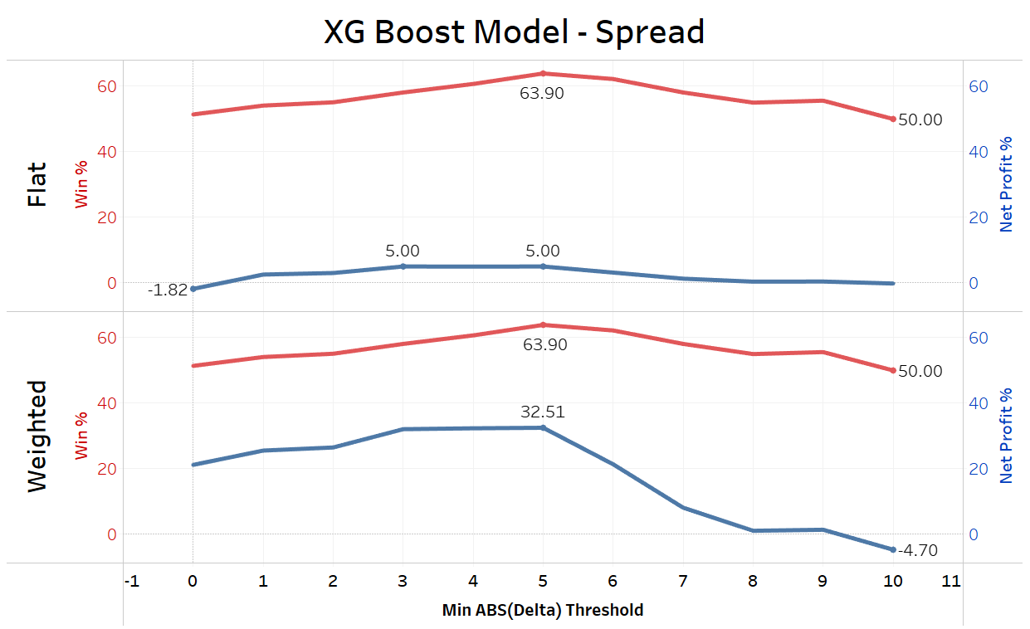
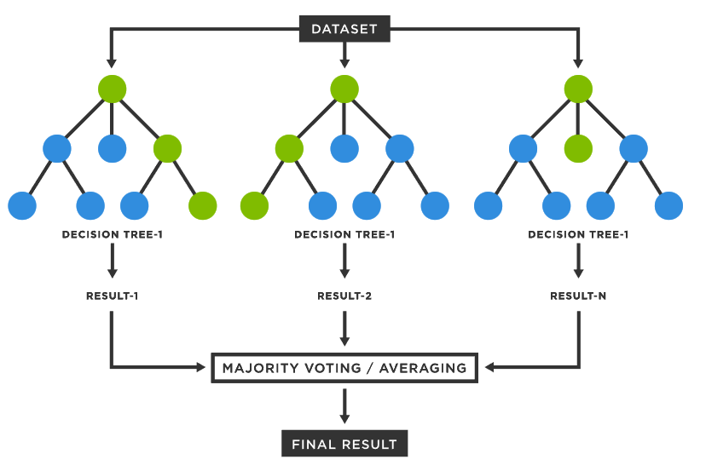
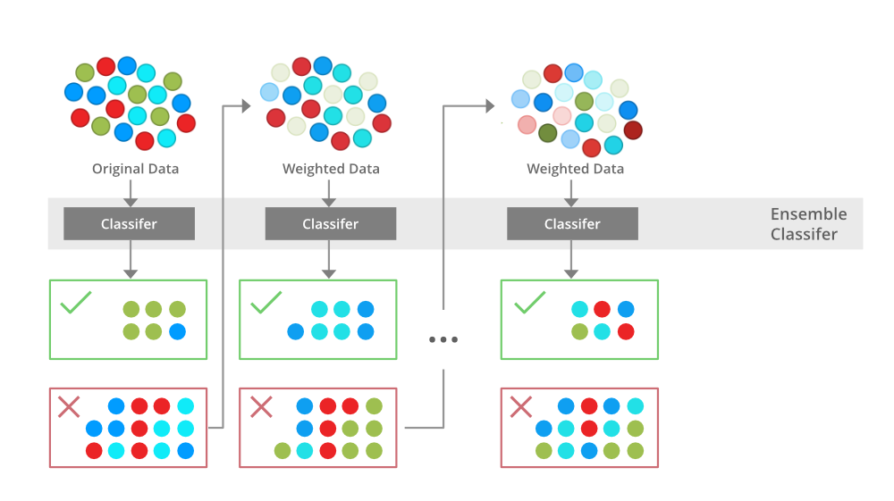
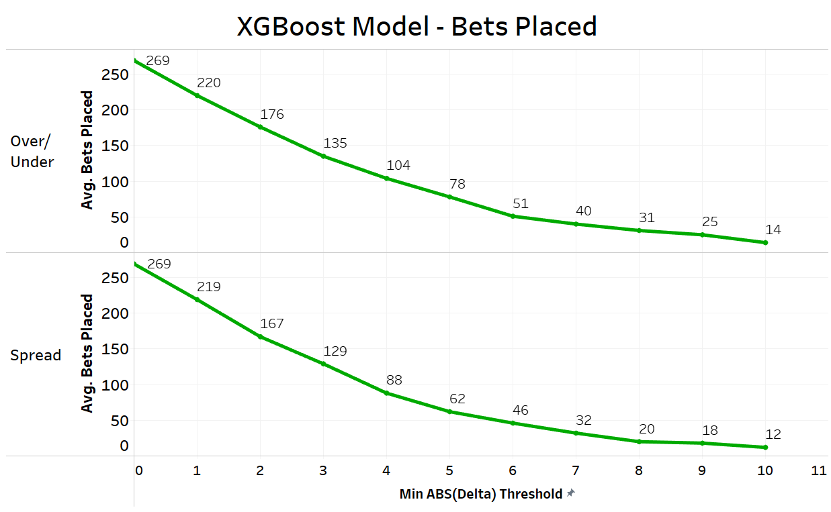
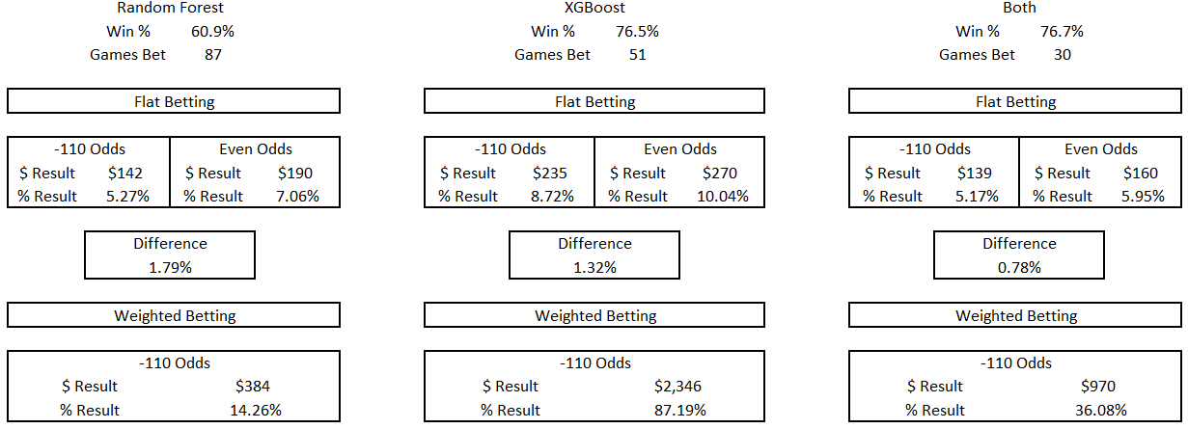
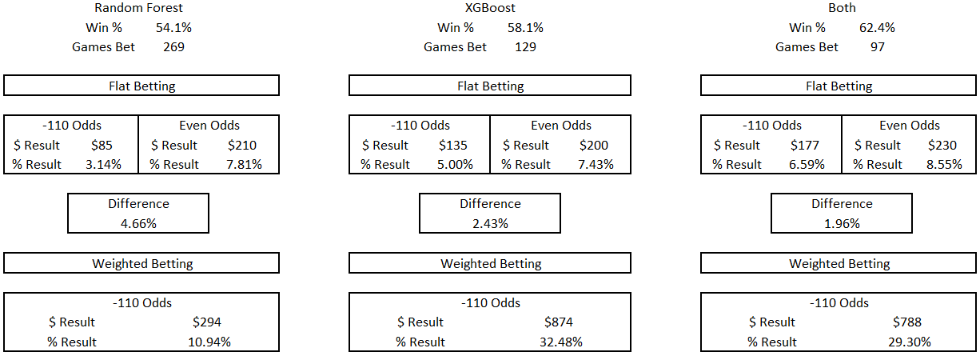
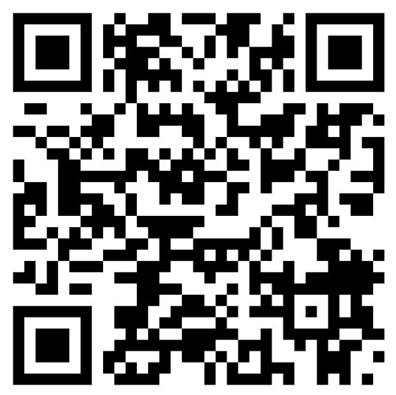
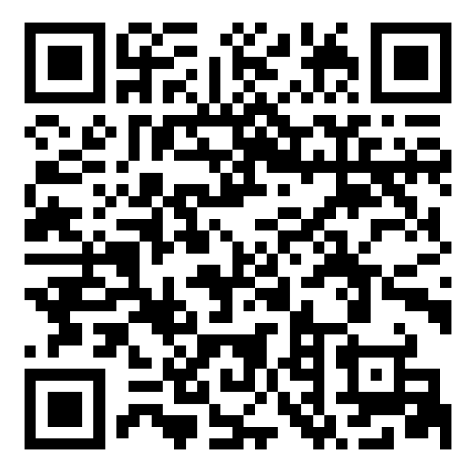
How to Beat Vegas Using Tree-Based Models
Jordan Butler – Spring 2026
INTRODUCTION
Dr. Austin Brown
DISCUSSION
American Sports Betting Industry 2023: $10.92B profit
Only 3-4% of sports bettors profit long term
Parlays = lottery/gambling, risk gained from “all or nothing” > added profit vs taking legs individually
Most popular straight bets: Over/Under and Spread
-110 odds on these give sportsbooks an inherent 4.76% house edge (-110 = implied probability of 52.38%, actual probability is an even 50%, O/U sometimes slightly less)
Contrary to popular belief, you CAN consistently make money betting on sports… and it’s all made possible by the power of statistical modeling
nflfastR: r package dataset containing 300+ attributes of data for every play in the NFL since 1999 (2 million+ rows)
Training data: 2003-2022, testing data: 2023
Game detail variables: roof, surface, weather, div_game, etc.
Team skill ranking metrics: epa, wpa
Betting metrics: spread, over/under
Response variables (created): difference (delta) between predicted total points / spread vs actual
Importance in being able to measure delta vs categorical response (bet over, bet home spread, etc.), allows easier threshold decisions for weighted betting
Similarities to counting cards in blackjack, beating casino in various other games, sports betting not as easily cracked down on
Thresholds/true count, weighted betting increments, etc.
Higher win $ doesn’t always equal higher net win %
At what point does being TOO picky with bets hurt you?
EV (Expected Value)
METHODS
Tree-based models
Type of supervised learning algorithm
Splits data at various nodes, each branch represents a different decision/factor level, follow line of branches down the tree to arrive at result/final decision
Random Forest model
Bagging algorithm, Splits data randomly into different subsets
Each node includes random subset of decisions/factor levels
Final branch of each original subset is 1 prediction of response variable, avg of all final branches = situational prediction
XGBoost
Gradient boosting algorithm, trees are built one after another rather than independently, each tree builds on result of previous
Predictions are aggregated along the way rather than only being compiled at the end
R CODE
## Random Forest Model – OU
set.seed(123)
RFM_OU = randomForest(total_delta ~ ., data = full_data_ou)
# Evaluating Model Accuracy
total_delta_pred = predict(RFM_OU, schedule_ou)
schedule_ou$total_delta_pred = round(total_delta_pred,3)View(schedule_ou)
## XG BOOST OU MODEL
set.seed(123)
grid_tune <- expand.grid(nrounds = 1500, max_depth = 2, eta = 0.1, gamma = 0, colsample_bytree = 1, min_child_weight = 1, subsample = 0.5)
train_control <- trainControl(method = "cv", number=3, verboseIter = TRUE, allowParallel = TRUE)
xgb_ou_tune <- train(x = full_data_num_ou[,-49], y = full_data_num_ou[,49], trControl = train_control, tuneGrid = grid_tune, method = "xgbTree", verbose = TRUE)
xgb_ou_tunetotal_delta_pred = predict(xgb_ou_tune, schedule_num_ou)
schedule_ou$total_delta_pred = round(total_delta_pred,3)
32.48
RESULTS
Random Forest Model
Likely under-fitting
Conservative
Some profit (lower ROR)
XGBoost Mode
Likely over-fitting
Aggressive
Maximum profit (higher ROR)
Combination
Perfectly molds under-fitting of RFM and over-fitting of XGB model, along with smaller yields of RFM and maximum yields of XGB, to produce highest win % and high net profit while keeping ROR to an acceptable level
Analysis of result spreads by factor level ≠ statistically accurate generalizations
Next steps: variable importance, model fine-tuning, increase test data sample size, test repeatability among different seeds, implementation
ABS(Delta) Threshold: 2
Over/Under
ABS(Delta) Threshold: 0
Spread
ABS(Delta) Threshold: 6
ABS(Delta) Threshold: 3
LINKS/QR CODES
LinkedIn
GitHub Portfolio

